Slide 1
Gun-Related Violence in the United States
By Dillon Groh

Slide 2
Introduction
The dataset that I am going to be using today is related to Gun Violence in the US.
This dataset is a comprehensive record of reports of gun violence from 2013-2022.
I decided to choose this dataset to research because of how prevalent the issue is these days. Gun violence, especially in schools is happening almost every week which is quite frightening as a student.
This topic I feel very strongly about because I am a student, but also because my girlfriend and mom are teachers at schools.
So, I fear for my life and their lives every single day. This is a problem that needs to be stopped because the way we have been going about this issue (by dismissing it and saying it’ll happen anyways) is doing nothing to stop the overall issue.
I hope that by using some of the statistical methods that we have learned throughout the semester, can shed light on the issue and can be brought to those in power to show that this was the issue five to ten years ago and it is getting so much worse.

Slide 3
Problems with Guns
There is an inherent problem with any incident that is caused by a gun. That they can result in a death.
To prove these problems, we will dive into the probability of a gun-related incident involving a death and using Chebyshev’s Theorem to figure out more information on the data with total deaths.

Slide 4
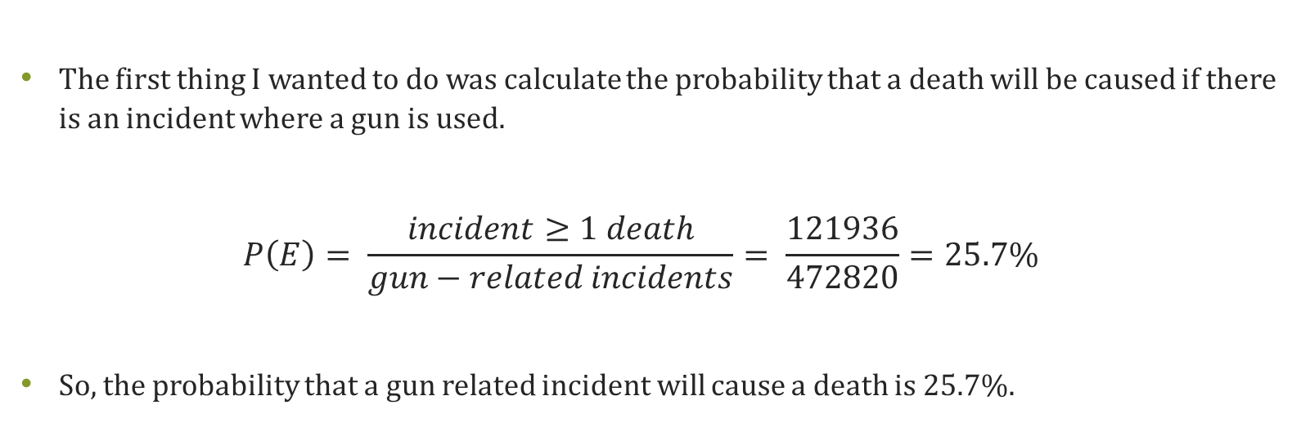
Probability of Death
The first thing I wanted to do was calculate the probability that a death will be caused if there is an incident where a gun is used.
$$P\left(E\right)= \frac{incident≥1 death}{gun−related incidents}= \frac{121936}{472820}=25.7\%$$
So, the probability that a gun related incident will cause a death is 25.7%.

Slide 5
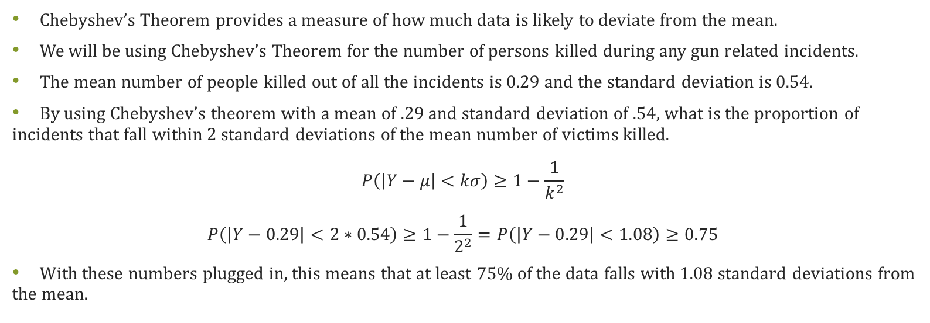
Chebyshev’s Theorem
Chebyshev’s Theorem provides a measure of how much data is likely to deviate from the mean.
We will be using Chebyshev’s Theorem for the number of persons killed during any gun related incidents.
The mean number of people killed out of all the incidents is 0.29 and the standard deviation is 0.54.
By using Chebyshev’s theorem with a mean of .29 and standard deviation of .54, what is the proportion of incidents that fall within 2 standard deviations of the mean number of victims killed.
$$P\left(\left|Y−μ\right|<kσ\right)≥1−\frac{1}{k^{2}}$$
$$P\left(\left|Y−0.29\right|<2∗0.54\right)≥1−\frac{1}{2^{2}}=P\left(\left|Y−0.29\right|<1.08\right)≥0.75$$
With these numbers plugged in, this means that at least 75% of the data falls with 1.08 standard deviations from the mean.

Slide 6
Reflection on Gun Violence
I think it is obvious that there is an issue in the number of deaths that are caused by guns.
This is shown from the probability problem and Chebyshev’s theorem.
Now we are going to look at two of the main issues that are caused by gun violence, mass shootings and Chicago.

Slide 7
Mass Shootings
The scariest type of gun-related incident are the ones that involve multiple casualties or injuries.
Nowadays they are happening at schools, concerts, movie theaters, banks, and even grocery stores.
It really feels like there is nowhere safe for us anymore besides the comfort of our homes.
Just by going out and being a normal person doing regular things, you are risking your life.
The statistics I am going to provide will support this thinking.

Slide 8
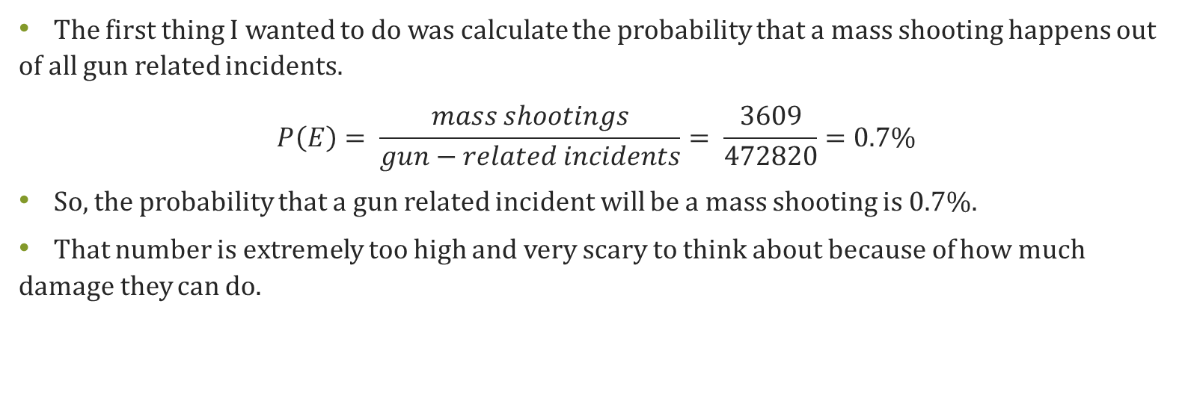
Probability of Mass Shooting to Incident
The first thing I wanted to do was calculate the probability that a mass shooting happens out of all gun related incidents.
$$P\left(E\right)= \frac{mass shootings}{gun−related incidents}= \frac{3609}{472820}=0.7\%$$
So, the probability that a gun related incident will be a mass shooting is 0.7%.
That number is extremely too high and very scary to think about because of how much damage they can do.

Slide 9
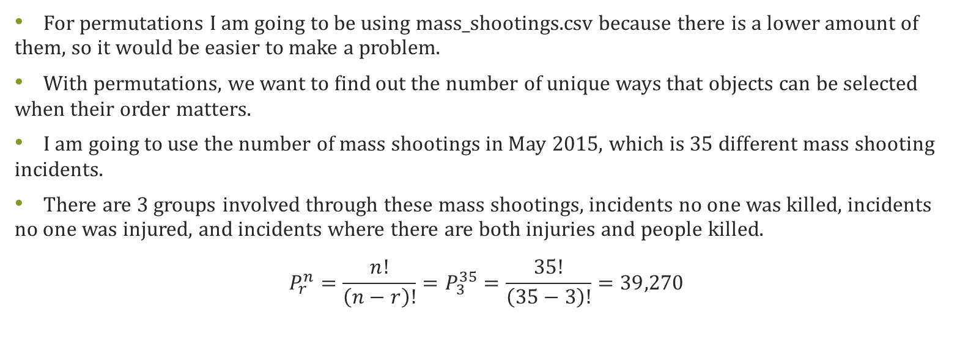
Permutation
For permutations I am going to be using mass_shootings.csv because there is a lower amount of them, so it would be easier to make a problem.
With permutations, we want to find out the number of unique ways that objects can be selected when their order matters.
I am going to use the number of mass shootings in May 2015, which is 35 different mass shooting incidents.
There are 3 groups involved through these mass shootings, incidents no one was killed, incidents no one was injured, and incidents where there are both injuries and people killed.
$$P_{r}^{n}=\frac{n!}{\left(n−r\right)!}=P_{3}^{35}=\frac{35!}{\left(35−3\right)!}=39,270$$

Slide 10
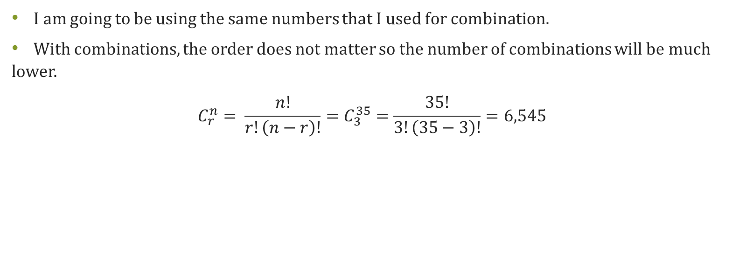
Combination
I am going to be using the same numbers that I used for combination.
With combinations, the order does not matter so the number of combinations will be much lower.
$$C_{r}^{n}= \frac{n!}{r!\left(n−r\right)!}=C_{3}^{35}=\frac{35!}{3!\left(35−3\right)!}=6,545$$

Slide 11
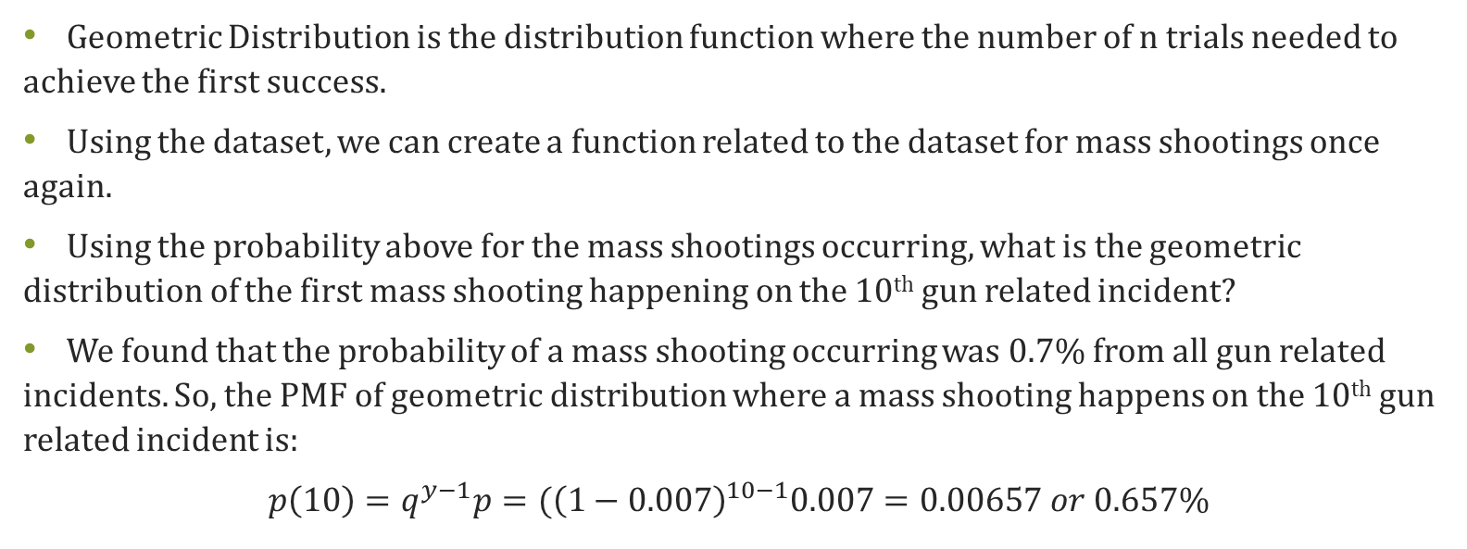
Geometric Distribution
Geometric Distribution is the distribution function where the number of n trials needed to achieve the first success.
Using the dataset, we can create a function related to the dataset for mass shootings once again.
Using the probability above for the mass shootings occurring, what is the geometric distribution of the first mass shooting happening on the 10th gun related incident?
We found that the probability of a mass shooting occurring was 0.7% from all gun related incidents. So, the PMF of geometric distribution where a mass shooting happens on the 10th gun related incident is:
$$p\left(10\right)=q^{y−1}p=({\left(1−0.007\right)}^{10−1}0.007=0.00657 or 0.657\%$$

Slide 12
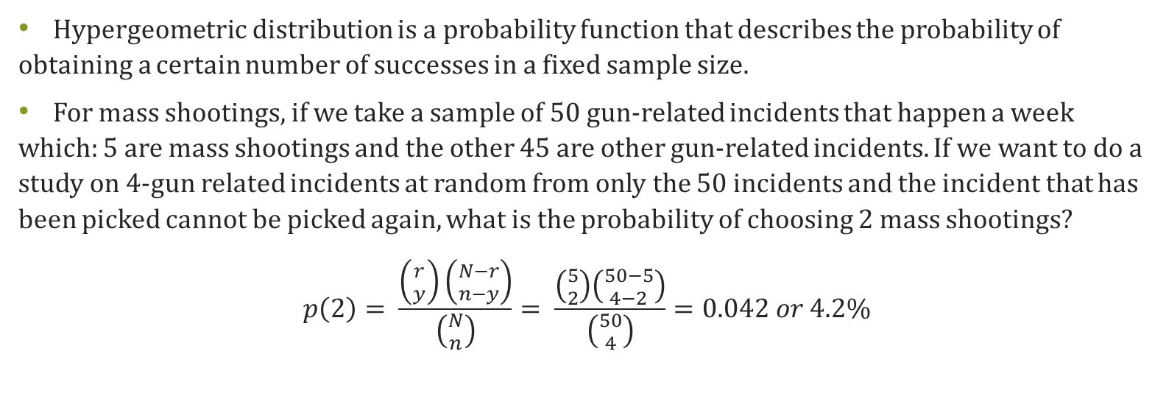
Hypergeometric Distribution
Hypergeometric distribution is a probability function that describes the probability of obtaining a certain number of successes in a fixed sample size.
For mass shootings, if we take a sample of 50 gun-related incidents that happen a week which: 5 are mass shootings and the other 45 are other gun-related incidents. If we want to do a study on 4-gun related incidents at random from only the 50 incidents and the incident that has been picked cannot be picked again, what is the probability of choosing 2 mass shootings?
$$p\left(2\right)= \frac{\left({r \atop y}\right)\left({N−r \atop n−y}\right)}{\left({N \atop n}\right)}= \frac{\left({5 \atop 2}\right)\left({50−5 \atop 4−2}\right)}{\left({50 \atop 4}\right)}=0.042 or 4.2\%$$

Slide 13
Reflection on Mass Shootings
After figuring out the statistical data behind mass shootings, the probability of them happening is a lot higher than it should be.
Mass shootings can lead to the same amount of damage as 5-10 gun-related incidents can cause.
The chances of there being a mass shooting is way too high, and my math is not wrong.
There are so many things that are causing these mass shootings, but there has been nothing done to try and stop or fix these issues.
People just send their thoughts and prayers and go on with their lives. Now is the time to start acting before it happens to one of our loved ones.

Slide 14
Chicago
Deemed one of the deadliest cities in the United States, Chicago is known for their crime rates and violence that involve guns.
Even though their state is blue, and they have gun laws, neighboring states have very loose gun laws that allow people to acquire these weapons very easily.
It is a tragedy to have to think of a city in this way, but the crime rates have always been bad and here I am going to look at some of the statistics for Chicago.

Slide 15
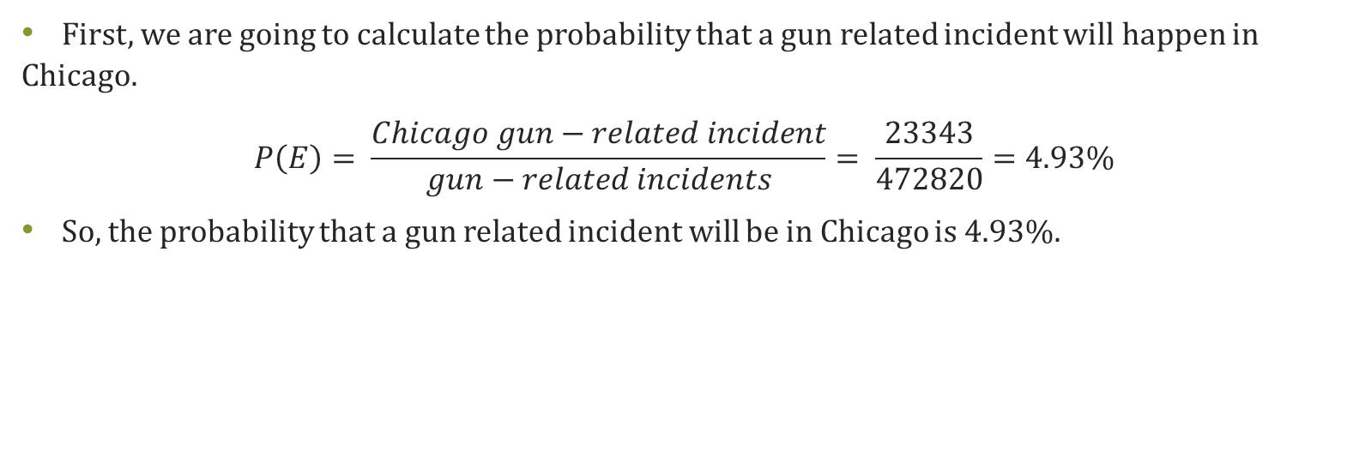
Probability of a Chicago Gun-Related Incident to Incident
First, we are going to calculate the probability that a gun related incident will happen in Chicago.
$$P\left(E\right)= \frac{Chicago gun−related incident}{gun−related incidents}= \frac{23343}{472820}=4.93\%$$
So, the probability that a gun related incident will be in Chicago is 4.93%.

Slide 16
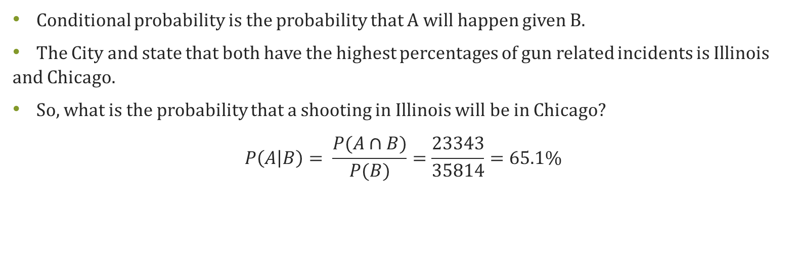
Conditional Probability
Conditional probability is the probability that A will happen given B.
The City and state that both have the highest percentages of gun related incidents is Illinois and Chicago.
So, what is the probability that a shooting in Illinois will be in Chicago?
$$P\left(A | B\right)= \frac{P(A∩B)}{P(B)}=\frac{23343}{35814}=65.1\%$$

Slide 17
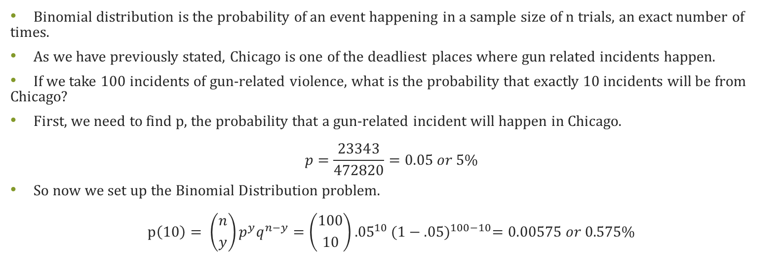
Binomial Distribution
Binomial distribution is the probability of an event happening in a sample size of n trials, an exact number of times.
As we have previously stated, Chicago is one of the deadliest places where gun related incidents happen.
If we take 100 incidents of gun-related violence, what is the probability that exactly 10 incidents will be from Chicago?
First, we need to find p, the probability that a gun-related incident will happen in Chicago.
$$p=\frac{23343}{472820}=0.05 or 5\%$$
So now we set up the Binomial Distribution problem.
$$p\left(10\right)= \left({n \atop y}\right)p^{y}q^{n−y}=\left({100 \atop 10}\right){.05}^{10}{(1−.05)}^{100−10}=0.00575 or 0.575\%$$

Slide 18
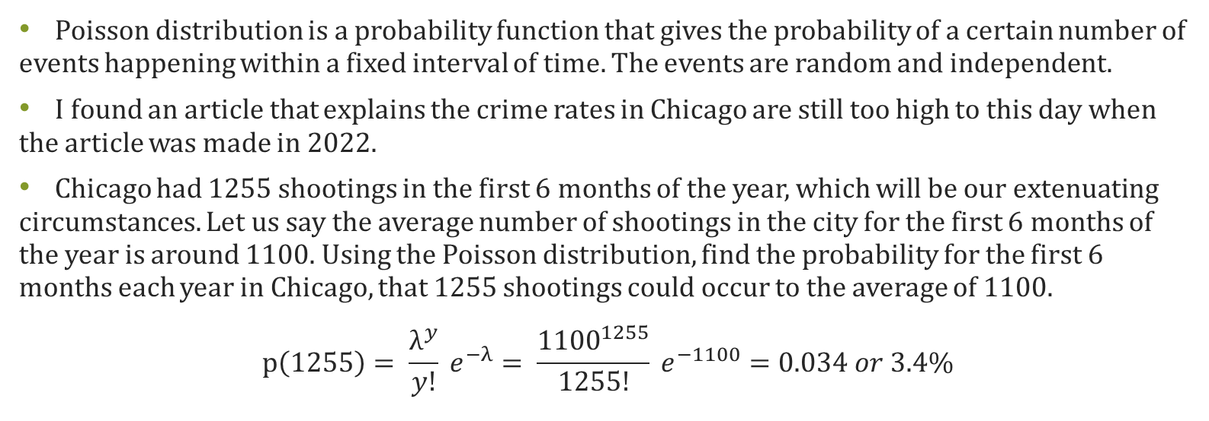
Poisson Distribution
Poisson distribution is a probability function that gives the probability of a certain number of events happening within a fixed interval of time. The events are random and independent.
I found an article that explains the crime rates in Chicago are still too high to this day when the article was made in 2022.
Chicago had 1255 shootings in the first 6 months of the year, which will be our extenuating circumstances. Let us say the average number of shootings in the city for the first 6 months of the year is around 1100. Using the Poisson distribution, find the probability for the first 6 months each year in Chicago, that 1255 shootings could occur to the average of 1100.
$$p\left(1255\right)= \frac{λ^{y}}{y!} e^{−λ}= \frac{{1100}^{1255}}{1255!} e^{−1100}=0.034 or 3.4\%$$

Slide 19
Reflection on Chicago
It is clear, due to the statistical work that I have done, that Chicago is a very dangerous city to live in.
The sources say that gun violence is down on the year, but still up because pandemic rates made it skyrocket.
There is an underlying issue and root of evil in Chicago, and nothing can be done to protect the state unless all states start following strict gun laws.
If one doesn’t follow, then what is the point?

Slide 20
Conclusion
I know this topic may seem very biased and leaning on one side politically, but I do not think that this issue should be a matter of choosing a political party.
I see myself as a libertarian and I believe in what I deem to be right.
I believe that the number one priority for the country is to protect its citizens no matter the cost.
To say there will be no change in the data that I have provided if stricter gun laws are set in place on a federal level is baffling and asinine.
I hope my statistical numbers do end up going down over time and it can feel safe to be a citizen in this country.

Slide 21
Sources
https://www.kaggle.com/datasets/emmanuelfwerr/gun-violence-incidents-in-the-usa?resource=download
https://blockclubchicago.org/2022/06/02/chicago-had-971-shootings-in-first-half-of-the-year-violence-is-trending-down-from-pandemic-peak-but-is-still-way-too-high-expert-says/
https://news.wttw.com/2022/07/01/shootings-homicides-down-year-chicago-still-pace-top-600-killings-2022-police

